Slide 1


Convolution Neural Network(CNN)
presented by:
k.kaviya

Slide 2
INTRODUCTION
What is CNN
•It is a class of deep learning.
•In this we do image recognition,images
classification and object detection.
•It is similar to neural network.

Slide 3
CNN Components
Convolution layer
Pooling layer
Fully connected layer

Slide 4
Convolution layer
INPUT
•An image is a matrix of pixel values.
•Each pixel range from 0 to 255.
•two images :
1. black & white
2. RGB image

Slide 5
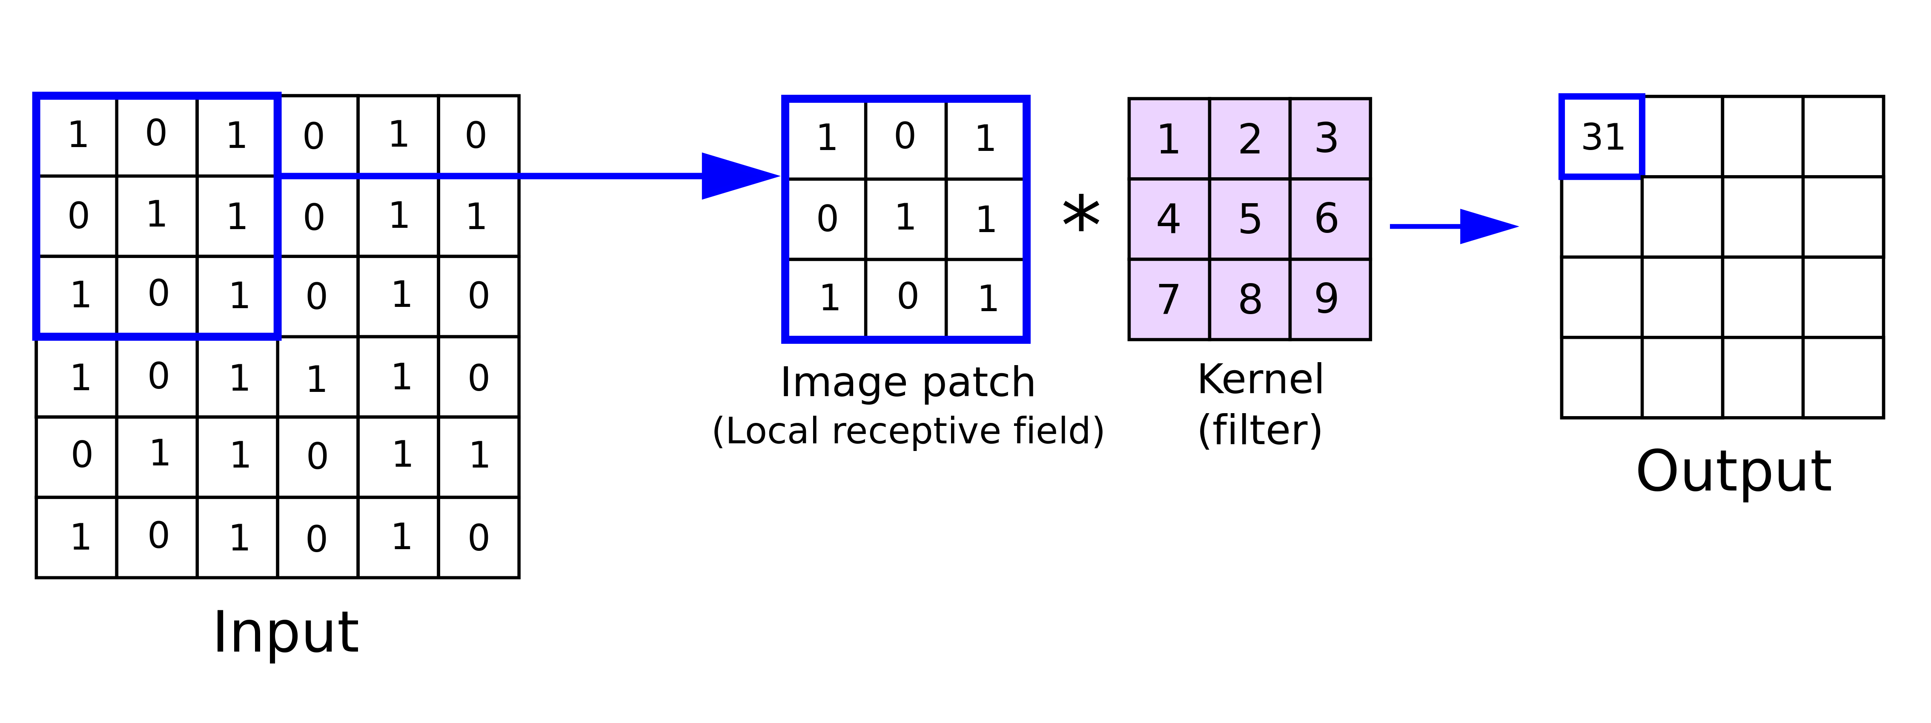
CONVOLUTION
The primary purpose of convolution in case of a CNN is to extract features from the input image.
Formula=n-f+1

Slide 6
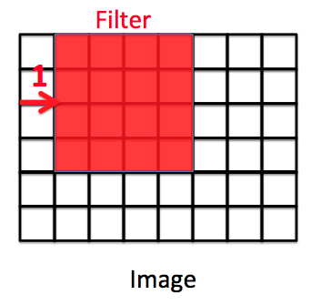
STRIDE
Stride is the number of pixels by which we slide our filter matrix over the input matrix.

Slide 7
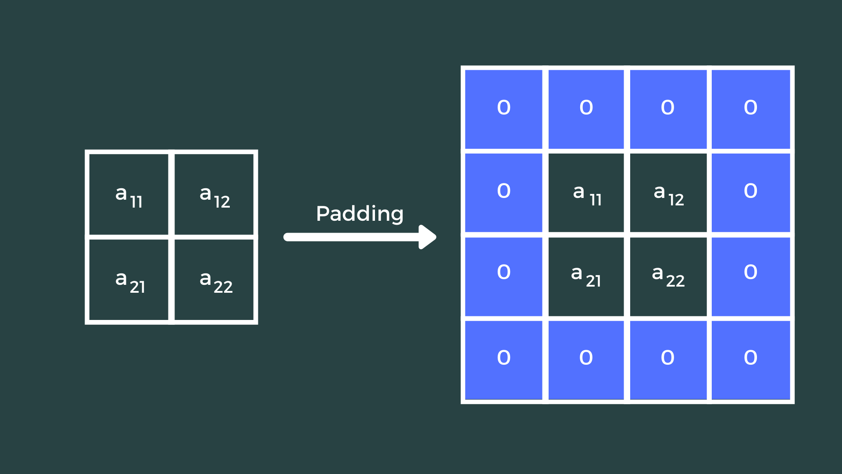
PADDING
• Protecting the image by adding another layer on the top.
•Building a compound among the images.
•n+2p-f+1

Slide 8
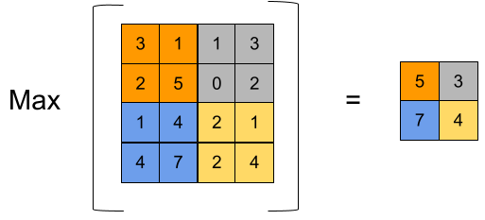
POOLING LAYER
To extract more and more clear information
The pooling operation involves sliding a two-dimensional filter over each channel of feature map and summarising the features lying within the region covered by the filter.
Types :
1.average pooling
2.min pooling
3. max pooling

Slide 9
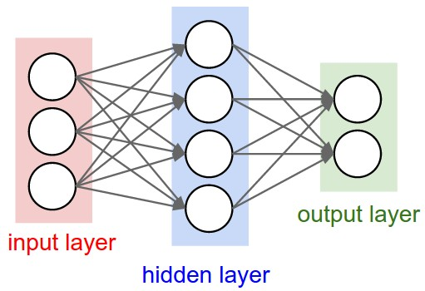
FULLY CONNECTED LAYER
A traditional multi-layer Percepter.
The every neuron in the previous layer is connected to every neuron on the next layer .
The purpose of the fully connected layer is to use the high level features for classifying the input image into various classes based on the training dataset.

Slide 10
THANK YOU

